Slide 1


Semester project
Dev1: Архипов Данил
Dev2/PO: Галиев Ильяс
Theme: cinema
KAZAN 2020

Slide 2
Goals
Develop website for booking tickets in a cinema
Implement ability to send reviews on films

Slide 3
Tools
C#
Razor pages
Asp.net core
Html
Css
Js
Linq2Db

Slide 4
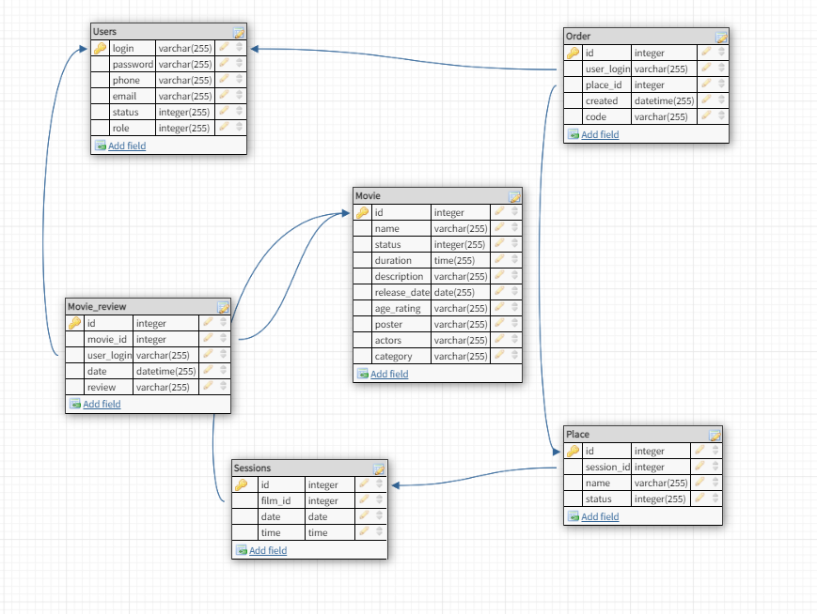

Slide 5
Implementation

Slide 6
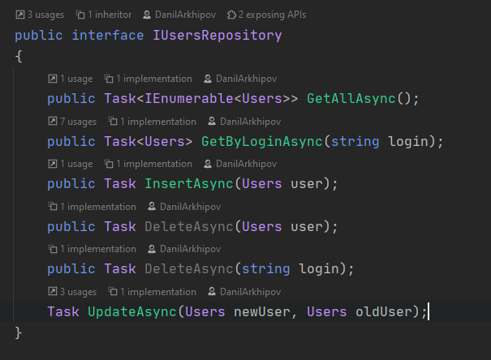
ORM

Slide 7
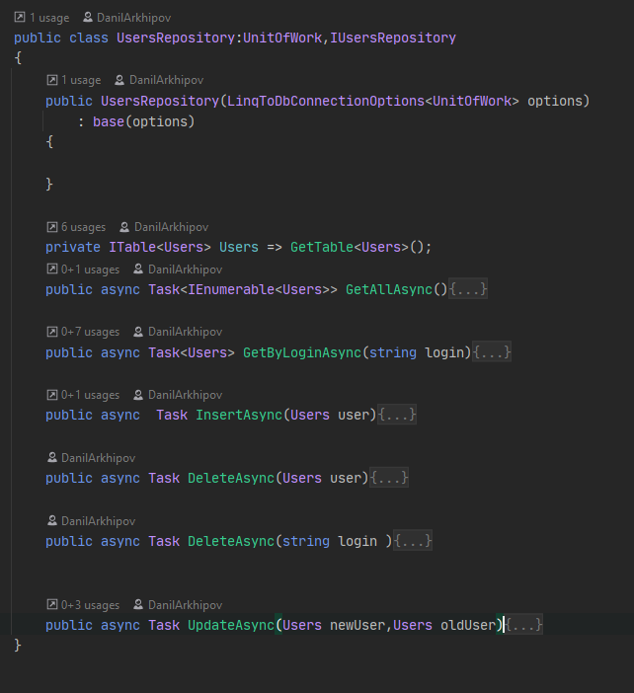

Slide 8
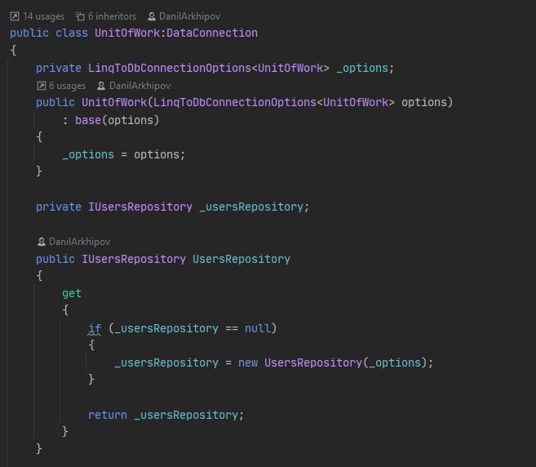

Slide 9
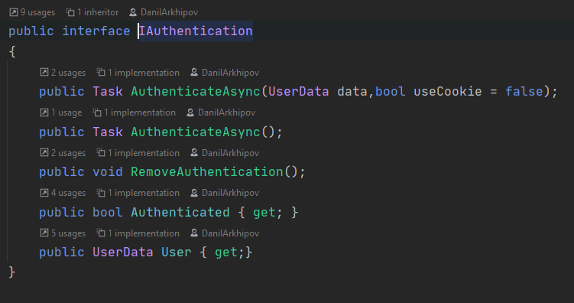
Authentication/Authorization

Slide 10
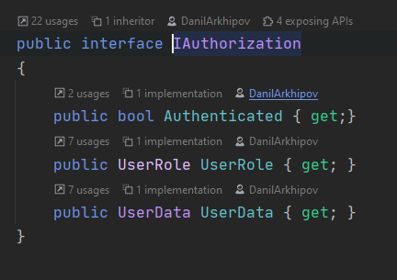

Slide 11
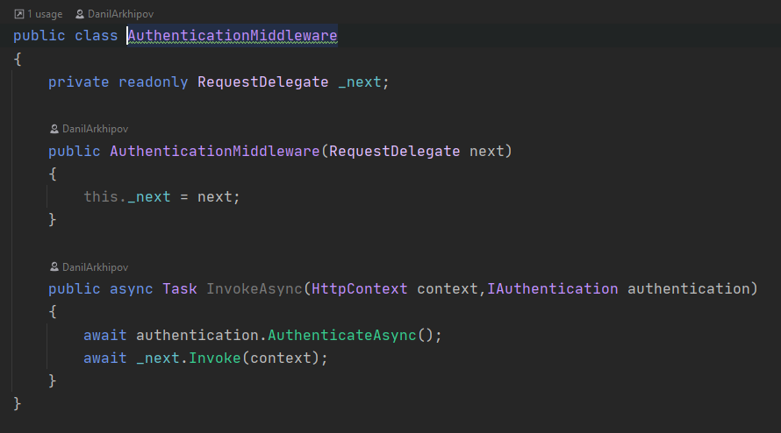

Slide 12
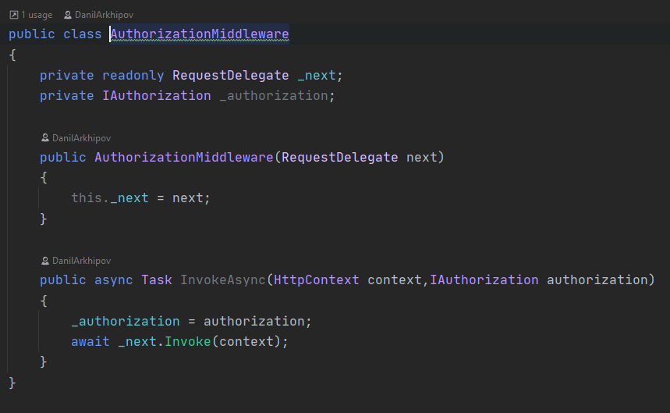

Slide 13
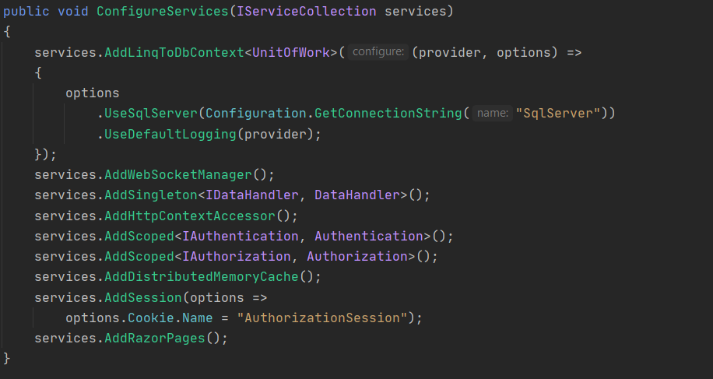

Slide 14
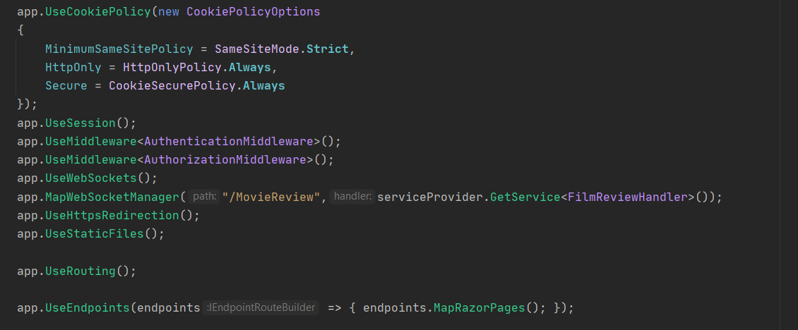

Slide 15
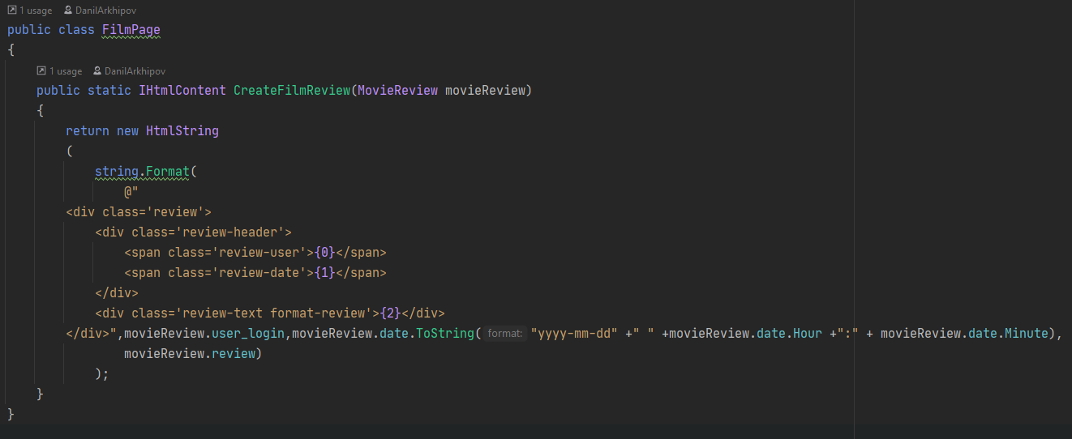
Html content generation

Slide 16
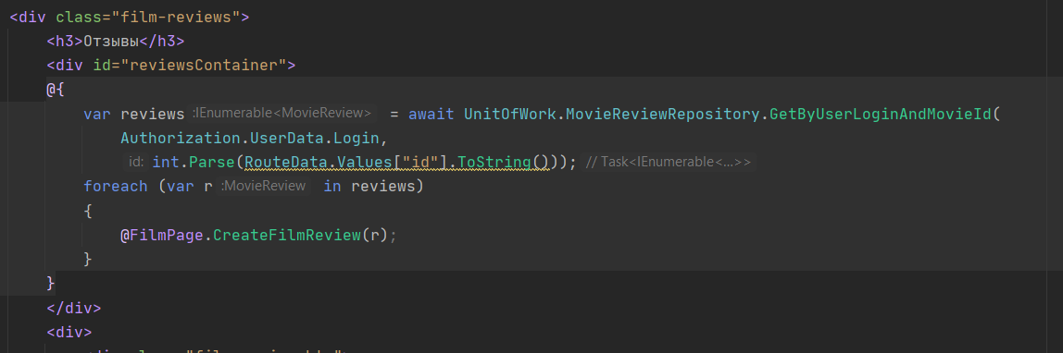

Slide 17
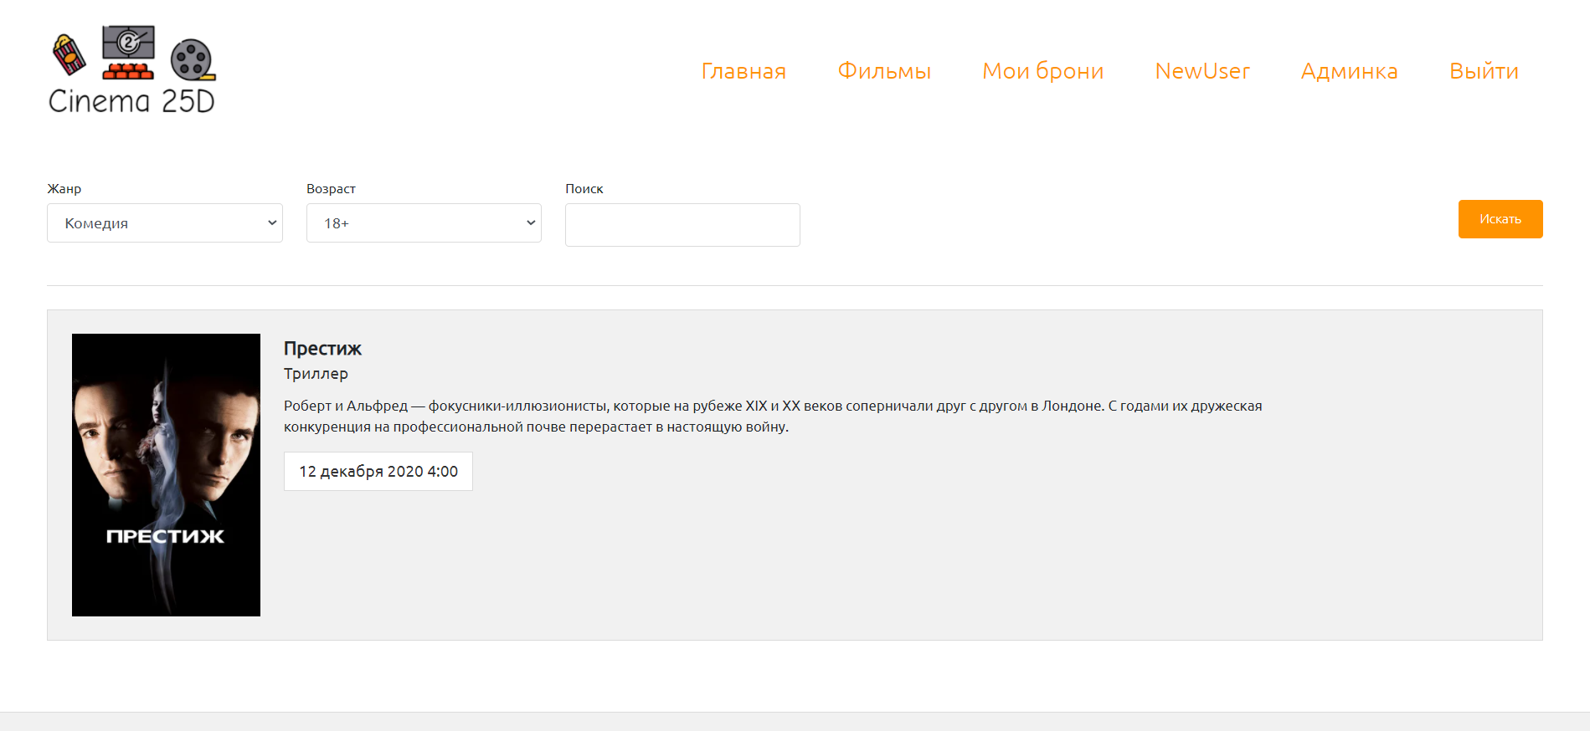

Slide 18
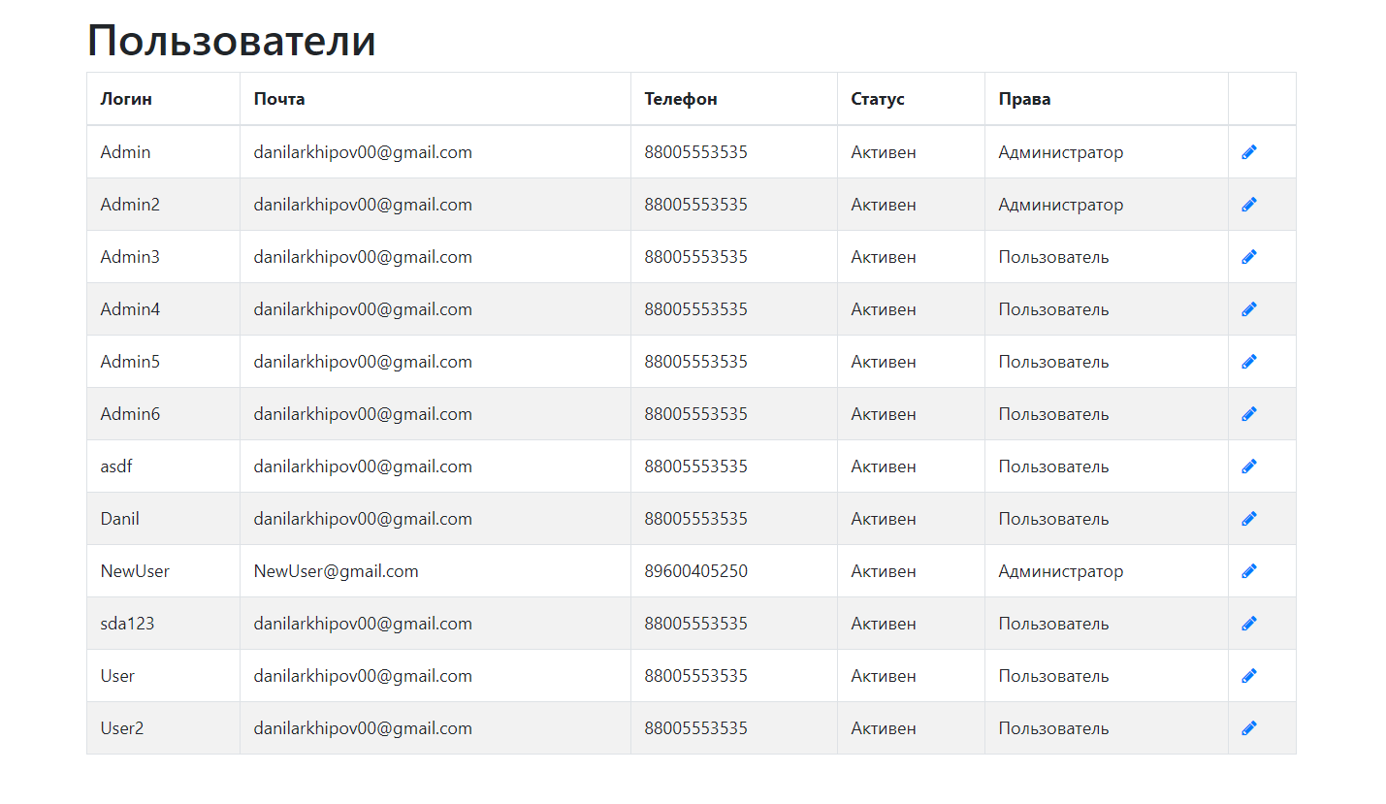

Slide 19
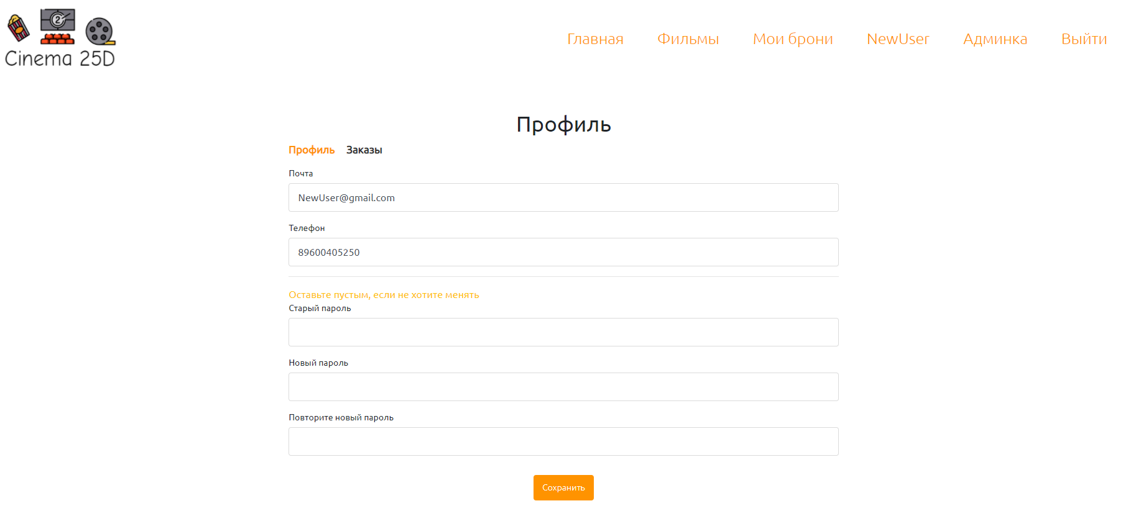

Slide 20
Thanks for attention
https://github.com/DanilArkhipov/cinemaProject

